Slide 1
Nakuja Internship 2026
Solid Propulsion Team
Weekly report #1
Presented by: Collins Kinyua
June 19, 2026

Slide 2
Tasks completed this week:
Began procurement process for new SRM casing and simulated possible solid rocket motor performance.
Design of new casing for ignition circuit system.
Wrote a report on mitigation of pressure spikes in BATES(BAllistic Test and Evaluation System) grain.
Failure analysis of previous static tests.

Slide 3
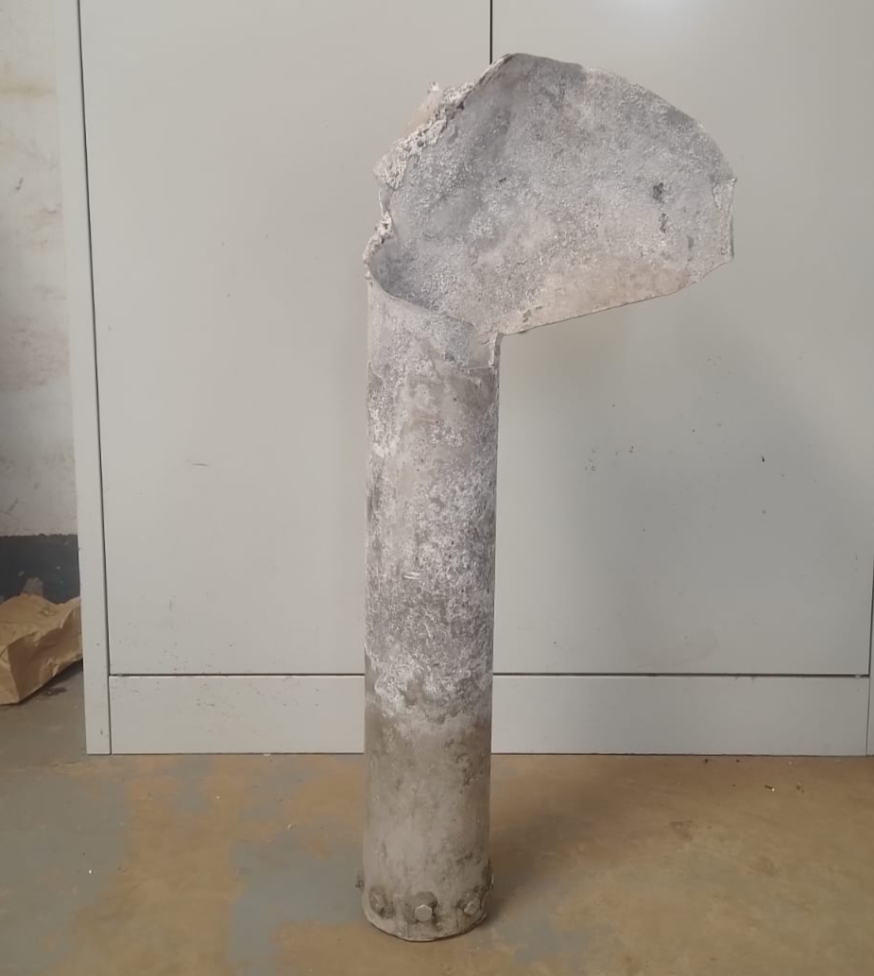
Procurement process for new casing and simulated SRM performance
Problem statement: Upon use of the Aluminum A6063-T5 casing during static fire testing led to rapid unscheduled disassembly (The motor exploded during static fire testing).
This indicated that the Aluminum casing could not withstand the simulated peak pressure value which necessitated a change of casing material.

Slide 4
The following materials were considered:
Mild steel SCH 160 -available in our inventory
Stainless steel G 316 -Kens Metal industries
Carbon steel seamless pipe schedule 40 Grade B API 5L -Kens metal industries.

Slide 5
Selected Material
Stainless steel G316 is the material to be used for the casing. It is selected for having a 2mm thickness and higher yield strength than aluminium.
See the full comparison table to aluminium here
Parameter | Aluminium 6063-T5 | Stainless Steel G316
Outer Diameter | 100 mm | 101.6 mm
Inner Diameter | 94 mm | 97.6 mm
Thickness (t) | 3 mm | 2 mm

Slide 6
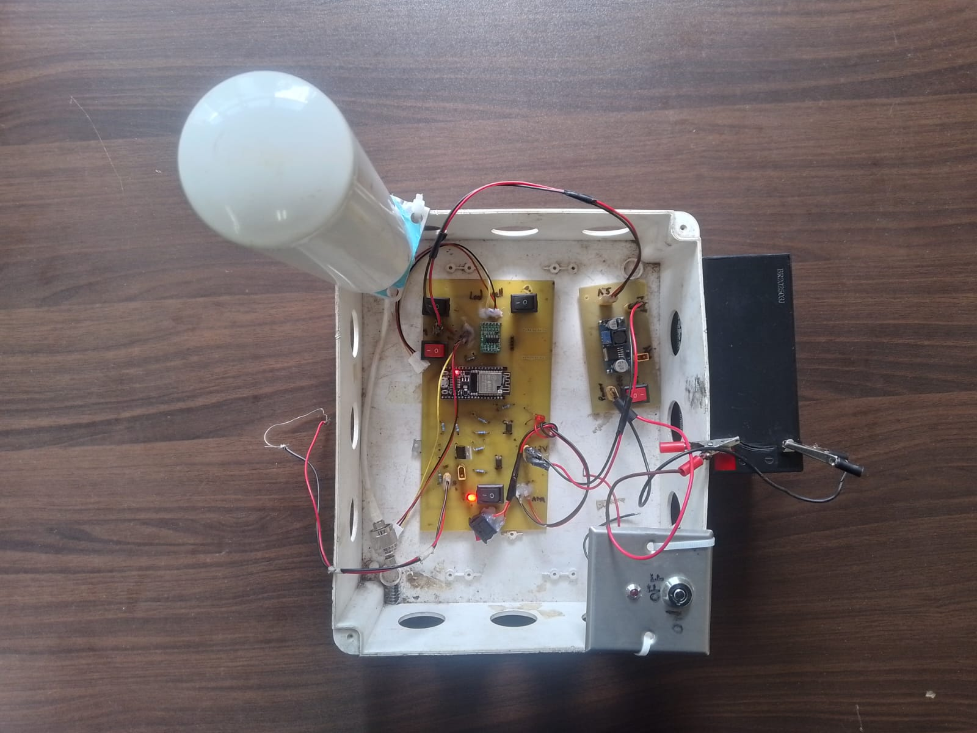
2. Design of new casing for ignition circuit.
Problem statement: During static fire testing, the current ignition circuit system (Trigger and Ignitor circuit) was bulky to transport and set-up prompting a change to a more compact and heat resistant design.
Old Design:

Slide 7
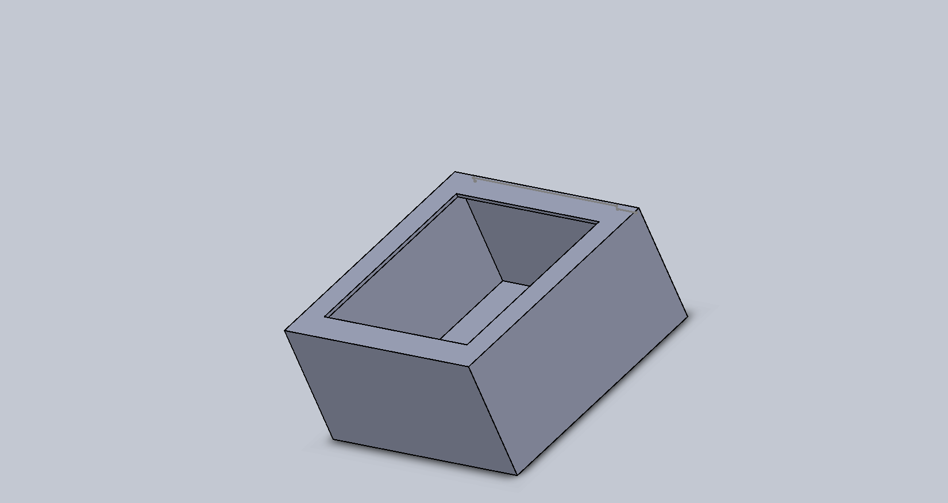
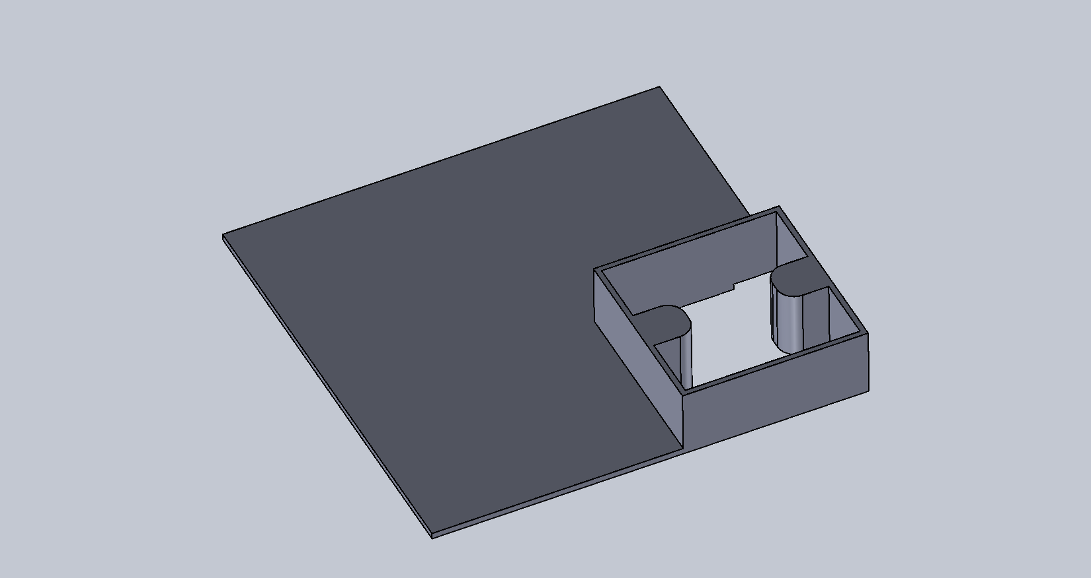
New proposed design:
Trigger casing Trigger top cover

Slide 8
3. Report on mitigation of pressure spikes in BATES grain.
Key findings:
Two main areas of focus were brought to attention:
Structural Integrity of the grain
Ignition timing

Slide 9
Structural Integrity
Problem faced:
Formation of air bubbles and voids -this causes rapid increase in chamber pressure contributing to CATO.
Erosive burning -this was observed by ejection of unburnt chunks of propellant during static test.
Proposed solutions:
Addition of surfactant -Sodium Laureth Sulphate(~1%), reduces the surface tension of sorbitol thus allowing wetting of KNO3 crystal without forming air bubbles and voids.
Addition of plasticizer -Glycerol(~1%) introduces flexibility to the binder thus allowing the grain to resist cracking during firing to prevent erosive burning

Slide 10
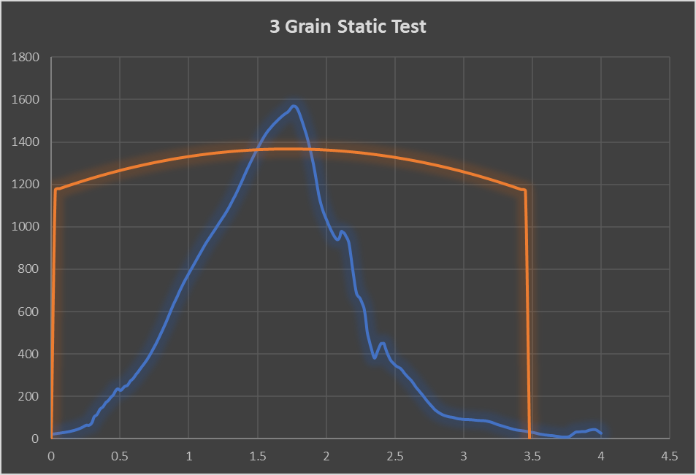
B. Ignition timing
Problem statement:
During previous static fire testing, delayed ignition was observed which contributes to non-uniform pressure rises.

Slide 11
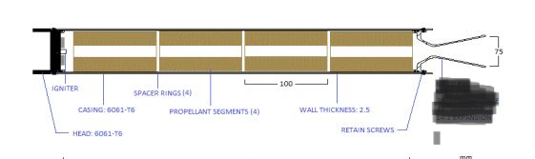
Proposed solution:
Implementation of a dual ignition sequence consisting of high-sensitivity primer (KNO3, Charcoal, Isopropyl Alcohol -Binding agent) and internal pyrogenic ignitor charge to ensure the entire grain surface initiates combustion simultaneously, preventing localised pressure surges caused by slow or uneven ignition.
Increase inter-grain spacing to 15% of grain diameter to allow for easy penetration of hot gases thus instantaneous ignition.

Slide 12
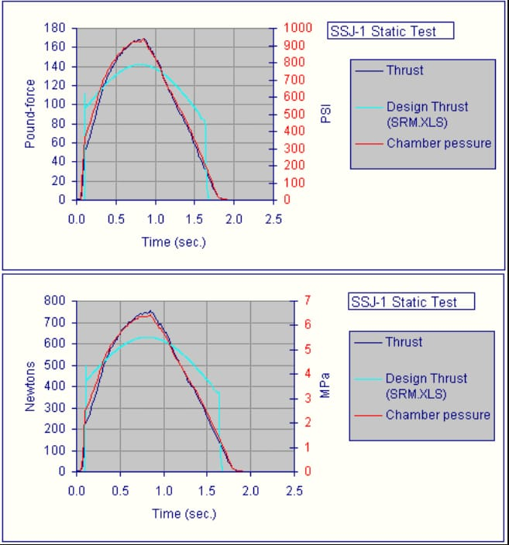
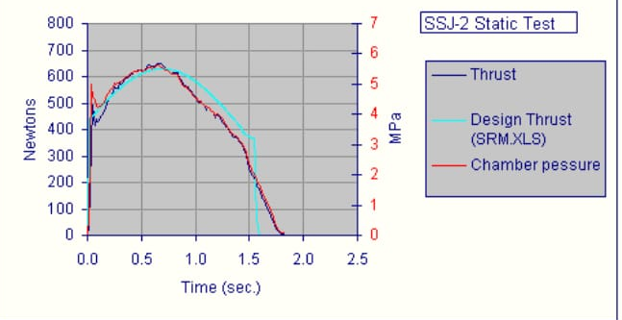
Effect of adding primer and increasing spacing between the grains inside the SRM
Delayed ignition without primer: Proper ignition with primer:
(Notice the time taken to reach 500N in both curves, it should be instantaneous)

Slide 13
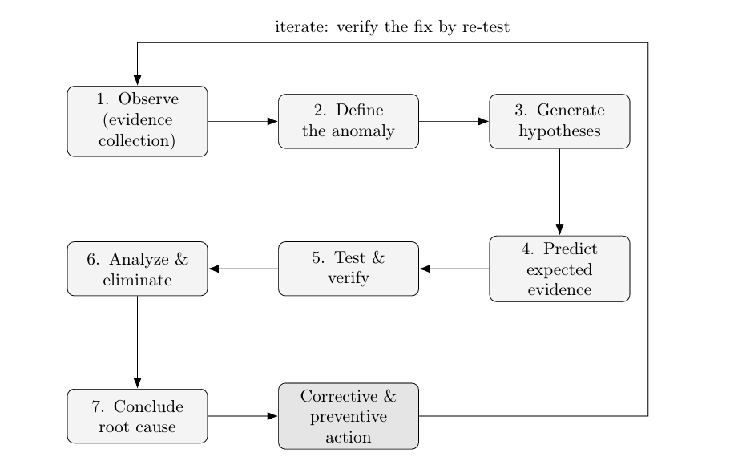
4. Failure analysis of previous static tests.
A scientific workflow for failure analysis was developed and will be used to record, analyse and provide possible solutions for why the previous N-4 SRM failed.
This is the workflow we came up with:

Slide 14
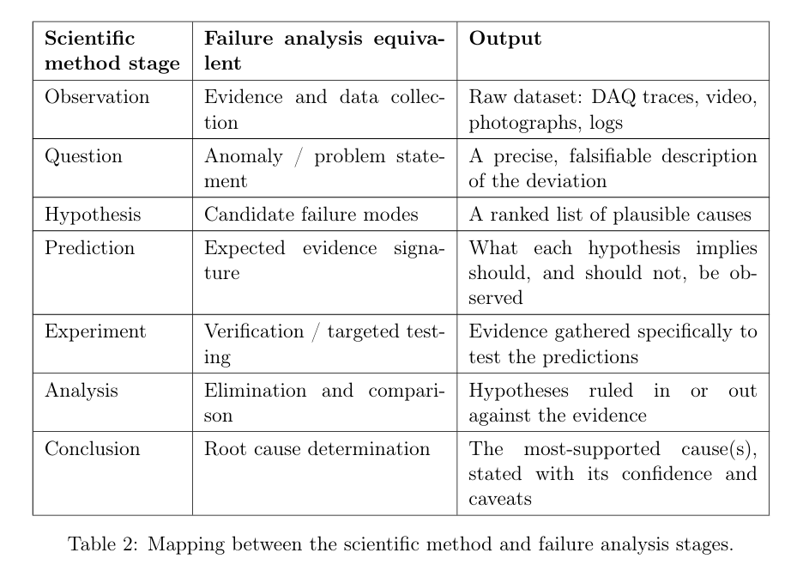

Slide 15
Challenges faced this week
Lack of internet connection hindered effective research.

Slide 16
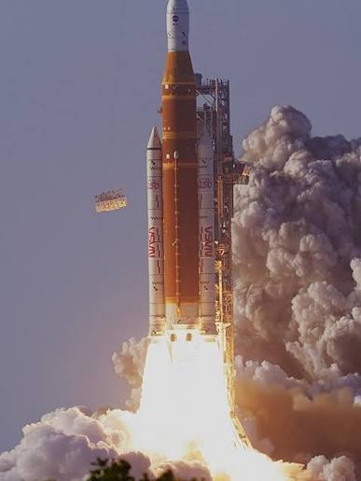
The End!

